Slide 1
Python 教學
Lorin Yeh

Slide 2
Python Control Statement
If….else
Condition
a == b, a != b, a < b, a <= b, a > b, a >= b
a = 33 b = 200 if b > a: print("b is greater than a")
if b > a: print("b is greater than a") elif a == b: print("a and b are equal")

Slide 3
Python Control Statement
If….else
Condition
and, or, not
a = 200 b = 33 c = 500 if a > b or a > c: print("At least one of the conditions is True")
if not a > b: print("a is NOT greater than b")

Slide 4
Python Control Statement
If….else
pass statement
a = 33 b = 200 if b > a: pass

Slide 5
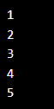
Python Control Statement
while loop
while condition
i = 1 while i < 6: print(i) i += 1

Slide 6
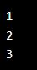
Python Control Statement
while loop
break statement
i = 1 while i < 6: print(i) if i == 3: break
i += 1

Slide 7
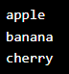
Python Control Statement
for loop
for iterating over a sequence (list, tuple, dictionary, set, or string) to execute a set of statements
fruits = ["apple", "banana", "cherry"] for x in fruits: print(x)

Slide 8
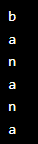
Python Control Statement
for loop
for iterating over a sequence (list, tuple, dictionary, set, or string) to execute a set of statements
for x in "banana": print(x)

Slide 9
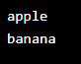
Python Control Statement
for loop
break statement
fruits = ["apple", "banana", "cherry"] for x in fruits: print(x) if x == "banana": break

Slide 10
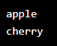
Python Control Statement
for loop
continue statement
fruits = ["apple", "banana", "cherry"] for x in fruits: if x == "banana": continue print(x)

Slide 11

Python Control Statement
for loop
range function
for x in range(6): print(x)

Slide 12

Python Control Statement
for loop
range function
for x in range(2, 6): print(x)

Slide 13
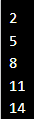
Python Control Statement
for loop
range function
for x in range(2, 15, 3): print(x)

Slide 14
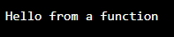
Python Functions
Function
A function is a block of code which only runs when it is called.
You can pass data, known as parameters, into a function
A function can return data as a result.
def my_function(): print("Hello from a function")
my_function()

Slide 15
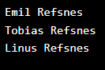
Python Functions
Function Arguments
def my_function(fname): print(fname + " Refsnes") my_function("Emil") my_function("Tobias") my_function("Linus")

Slide 16
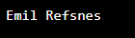
Python Functions
Function Arguments
def my_function(fname, lname): print(fname + " " + lname) my_function("Emil", "Refsnes")

Slide 17
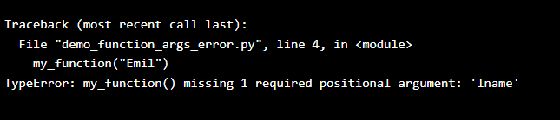
Python Functions
Function Arguments
def my_function(fname, lname): print(fname + " " + lname) my_function("Emil")

Slide 18
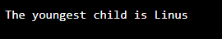
Python Functions
keyword Arguments
def my_function(child3, child2, child1): print("The youngest child is " + child3) my_function(child1 = "Emil", child2 = "Tobias", child3 = "Linus")

Slide 19
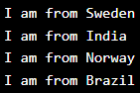
Python Functions
Argument default value
def my_function(country = "Norway"): print("I am from " + country) my_function("Sweden") my_function("India") my_function() my_function("Brazil")

Slide 20
Python Class and Object
Object Oriented Programming
Python is an object oriented programming language.
Almost everything in Python is an object, with its properties and methods

Slide 21
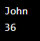
Python Class and Object
__init__(…), the constructor
class Person: def __init__(self, name, age): self.name = name self.age = age p1 = Person("John", 36) print(p1.name) print(p1.age)

Slide 22
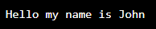
Python Class and Object
Object Methods
class Person: def __init__(self, name, age): self.name = name self.age = age def myfunc(self): print("Hello my name is " + self.name) p1 = Person("John", 36) p1.myfunc()

Slide 23
Python Class and Object
Object Methods
self parameter, a reference to the current instance of the class
class Person: def __init__(self, name, age): self.name = name self.age = age def myfunc(self): print("Hello my name is " + self.name) p1 = Person("John", 36) p1.myfunc()

Slide 24
Python Class and Object
Inheritance
Parent and Child(or Derived) class
class Person: def __init__(self, fname, lname): self.firstname = fname self.lastname = lname def printname(self): print(self.firstname, self.lastname) x = Person("John", "Doe") x.printname()

Slide 25
Python Class and Object
Inheritance
class Person:
def __init__(self, fname, lname):
self.firstname = fname
self.lastname = lname
def printname(self):
print(self.firstname, self.lastname)
class Student(Person):
def __init__(self, fname, lname, year):
super().__init__(fname, lname)
self.graduationyear = year
x = Student("Mike", "Olsen", 2019)

Slide 26
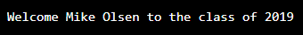
Python Class and Object
Inheritance
class Student(Person):
def __init__(self, fname, lname, year):
super().__init__(fname, lname)
self.graduationyear = year
def welcome(self):
print("Welcome", self.firstname, self.lastname, "to the class of", self.graduationyear)
x = Student("Mike", "Olsen", 2019)
x.welcome()

Slide 27
Python Class and Object
Class Polymorphism
class Vehicle: def __init__(self, brand, model): self.brand = brand self.model = model def move(self): print("Move!") class Car(Vehicle): pass class Boat(Vehicle): def move(self): print("Sail!") class Plane(Vehicle): def move(self): print("Fly!")

Slide 28
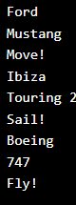
Python Class and Object
Class Polymorphism
car1 = Car("Ford", "Mustang") #Create a Car object boat1 = Boat("Ibiza", "Touring 20") #Create a Boat object plane1 = Plane("Boeing", "747") #Create a Plane object for x in (car1, boat1, plane1): print(x.brand) print(x.model) x.move()

Slide 29
ACTS Shell Class Example
APIs for Sending command in Device Console or WKS Shell
Use_Device_WKS_Login(shell, type, user_name, password,…)
type : COM, SSH, TELNET, ExpectSSH, CMD

Slide 30


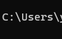
ACTS Shell Class Example
Use_Device_WKS_Login
COM
(RS-232)
SSH
TELNET
ExpectSSH
CMD
ssh.exe

Slide 31
ACTS Shell Class Example
APIs for Sending command in Device Console or WKS Shell
Use_Device_WKS_Login(shell, type, user_name, password,…)
type : COM, SSH, TELNET, ExpectSSH, CMD
CI_Cmd_More([(“cmd1”, timeout), (“cmd”, timeout),….])
Send cmd to device console or wks shell and wait the prompt
CI_Cmd_Scan(cmd, timeout, ([(“label”, “value”),….])
Send cmd to device console or wks shell and check responses strings

Slide 32
ACTS Shell Class Example
CShellBase
sendCmd(): send cmd to console, SSH, Telnet, or DosBox
CiCmdMore(): call sendCmd() and get prompt chars from recvFIFO
CiCmdScan(): call sendCmd(), get received chars from recvFIFO
and check them
For different shell type, has different sendCmd()
All them have same recvFIFO, CiCmdMore() and CiCmdScan()
recvFIFO
sendCmd()
CiCmdMore()
CiCmdScan()

Slide 33
ACTS Shell Class Example
class CShellBase:
def __init__(self, shell_name, type,……):
self.recvFIFO =deque([])
def openPort(self):
pass
def sendCmd(self,….):
pass
def CiCmdMore(self, [cmd…..]):
for all cmds:
self.sendCmd(….)
readAllChar(…)
CShellBase
recvFIFO
Will be overwritten by child
sendCmd()
CiCmdMore()
CiCmdScan()
Will be overwritten by child
Will be inherited by child

Slide 34
ACTS Shell Class Example
CComPort
class CComPort(CShellBase):
def __init__(self, shell_name, type,……):
super().__init__(.., “COM”,……)
self.openPort(…..)
def openPort(self):
self.serialCom = serial.Serial
self.serialCom.open()
def sendCmd(self, cmd, ….):
self.serialCom.write(cmd)
class CShellBase:
def __init__(self, shell_name, type,……):
self.recvFIFO =deque([])
CShellBase
recvFIFO
sendCmd()
CiCmdMore()
CiCmdScan()
openPort()
sendCmd()
def CiCmdMore(self, [cmd…..]):
for all cmds:
self.sendCmd(….)
readAllChar(…)
Inherited from
CShellBase

Slide 35
ACTS Shell Class Example
CSshShell
class CSshShell(CShellBase):
def __init__(self, shell_name, type,……):
super().__init__(.., “SSH”,……)
self.openPort(….)
def openPort(self):
self.client = paramiko.SSHClient()
self.client.connect(…)
def sendCmd(self, cmd, ….):
stdin, stdout, stderr = self.client.exec_command(cmd)
class CShellBase:
def __init__(self, shell_name, type,……):
self.recvFIFO =deque([])
CShellBase
recvFIFO
sendCmd()
CiCmdMore()
CiCmdScan()
openPort()
sendCmd()
def CiCmdMore(self, [cmd…..]):
for all cmds:
self.sendCmd(….)
readAllChar(…)
Inherited from
CShellBase

Slide 36
ACTS Shell Class Example
CTelnetShell
class CTelnetShell(CShellBase):
def __init__(self, shell_name, type,……):
super().__init__(..,”TELNET”,……)
self.openPort(…)
def openPort(self):
self.client = telnetlib.Telnet()
self.client.open(…)
def sendCmd(self, cmd, ….):
self.client.write(cmd, …)
class CShellBase:
def __init__(self, shell_name, type,……):
self.recvFIFO =deque([])
CShellBase
recvFIFO
sendCmd()
CiCmdMore()
CiCmdScan()
openPort()
sendCmd()
def CiCmdMore(self, [cmd…..]):
for all cmds:
self.sendCmd(….)
readAllChar(…)
Inherited from
CShellBase

Slide 37
ACTS Shell Class Example
In Use_Device_WKS_Login
# Create a shell object
If type == “SSH”:
obj_shell = CSshShell(shell_name, “SSH”……)
elif type == “Telnet”:
obj_shell = CTelnetShell(shell_name, “TELNET”……)
elif type == “ExpectSSH”:
obj_shell = CExpectSsh(shell_name, “ExpectSSH”……)
def CI_Cmd_More ([(cmd, ..),(cmd,..), ]):
objCurrentShell.CiCmdMore(……)
……………………………………………………………

Slide 38
ACTS Shell Class Example
Use_Device_WKS_Login()
CI_Cmd_More()
CI_Cmd_Scan()
def CI_Cmd_More ([(cmd, ..),(cmd,..), ]):
objCurrentShell.CiCmdMore(……)
……………………………………………………………
COM
(RS-232)
ExpectSSH
SSH
TELNET
CMD
objCurrentShell
CShellBase
CiCmdMore()
CShellBase
CiCmdMore()
CShellBase
CiCmdMore()
CShellBase
CiCmdMore()
CShellBase
CiCmdMore()
CComPort
sendCmd()
CSshShell
sendCmd()
CTelnetShell
sendCmd()
CExpectSsh
sendCmd()
CCmdShell
sendCmd()
ssh.exe

Slide 39
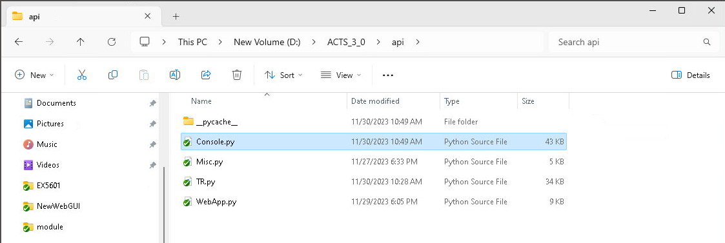
Exercise
請將該檔案內的所有 function 在 ACTS 3.0 內練習執行成功，
並設想什麼樣的 Test Case，可呼叫那些 function API.

Slide 40
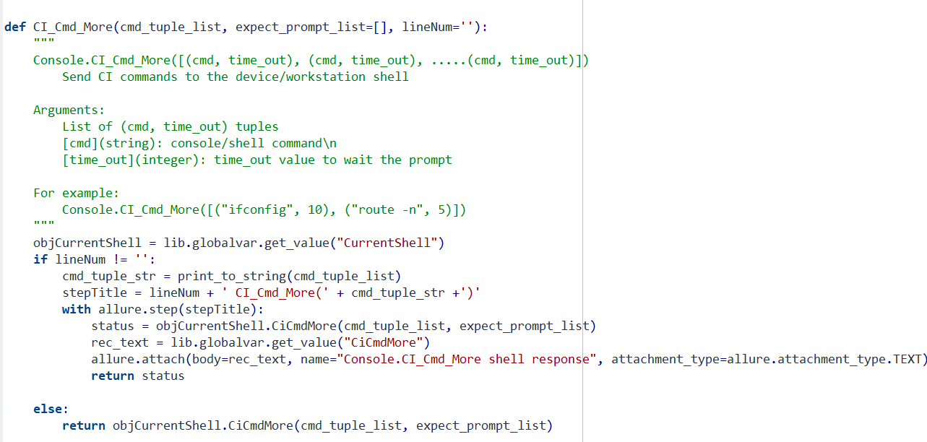
Exercise

Slide 41
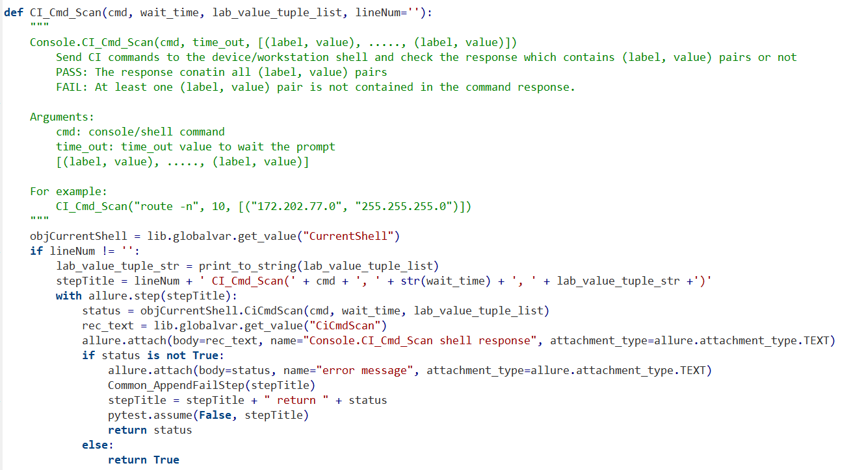
Exercise

Slide 42
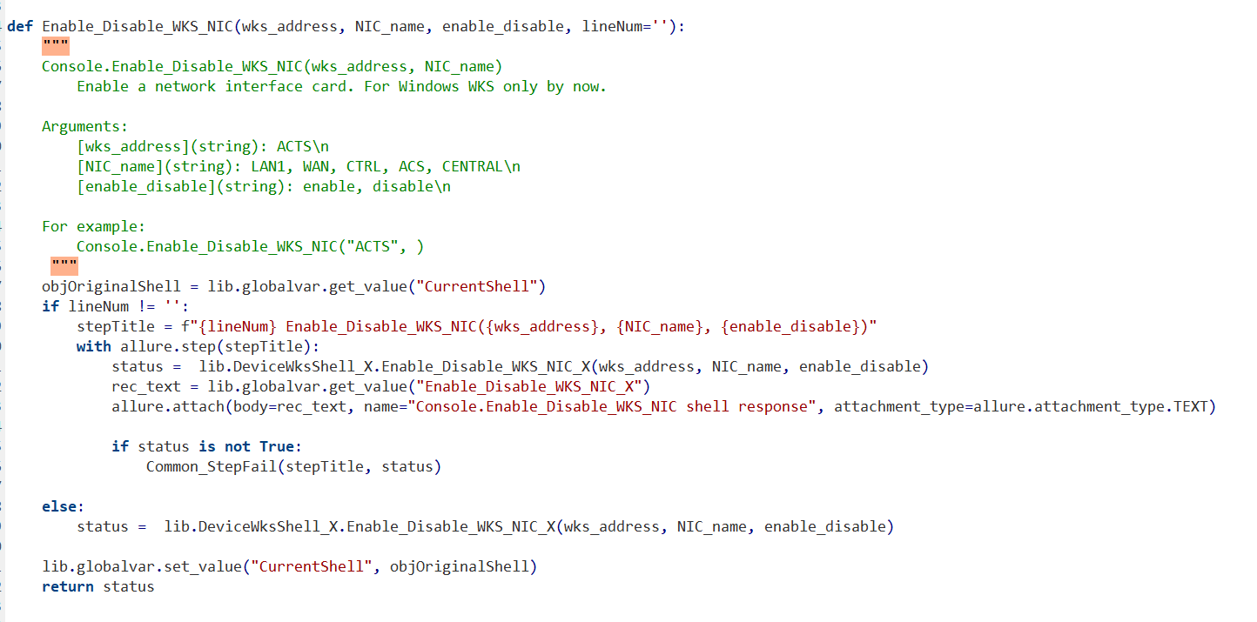
Exercise

Slide 43
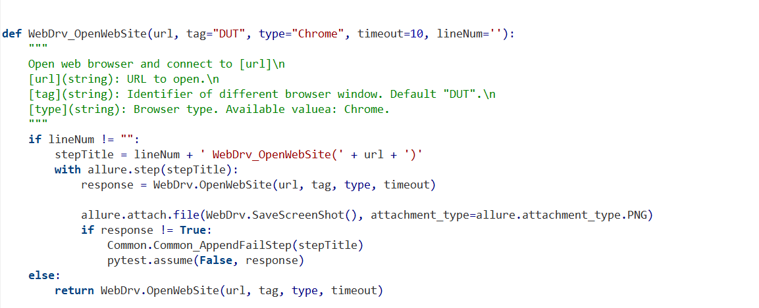
Exercise

Slide 44
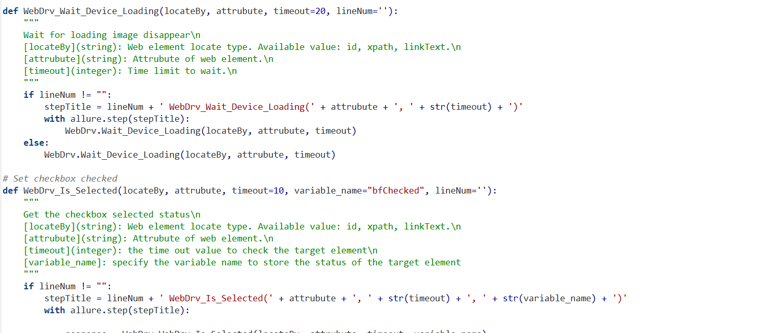
Exercise

